Slide 1
Fire Plumes –FireWork/GEMMACH vs. MISR
Prepared by: Elisa Dong
Mar 21, 2016

Slide 2
Goals
Analyze operational FireWorks plumerise results against MISR (MINX) results
Find potential issues/bias using MINX
Establish benchmark for upcoming comparison with CFFEPS

Slide 3
Coverage
Apr – Oct 2017 (i.e. 2017 fire season)
All of Canada (10 km domain)
Sample Command using preMINX
preMINX -L -142.0 -50.7 42.0 83.0 -d 2017.07.01 2017.07.31 -u elisadong --grandir ./granules

Slide 4
Process
Download appropriate MISR/MODIS data, FirePixels (preMINX)
Filter FirePixels by percentile (FRP), then confidence level (P50, C60) to reduce digitizing efforts
Digitize plumes (MINX4), user selects appropriate bands
Pass through several functions (postMINX, speedAltMINXdemo, binPercentiles, etc)
Naming sense is not great

Slide 5
Model Plumes
Determination of Model Plume location is dependent on
Digitized plume location
Model: Ops. FireWork FST – GEMMACH FST
Threshold: AF > 0
StartTime: 00 (f00-f24)
Local Max of AF values from model
Notes:
Possibly include an illustration
Note: FireWork – GEMMACH allows for threshold 0 because anthropomorphic affects. If only looking at the FireWork results, would require setting threshold to something higher (ex. 15). StartTimes indicate what time during the day the model starts running.

Slide 6
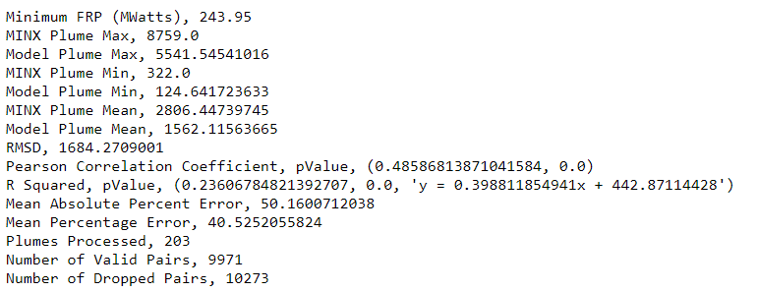
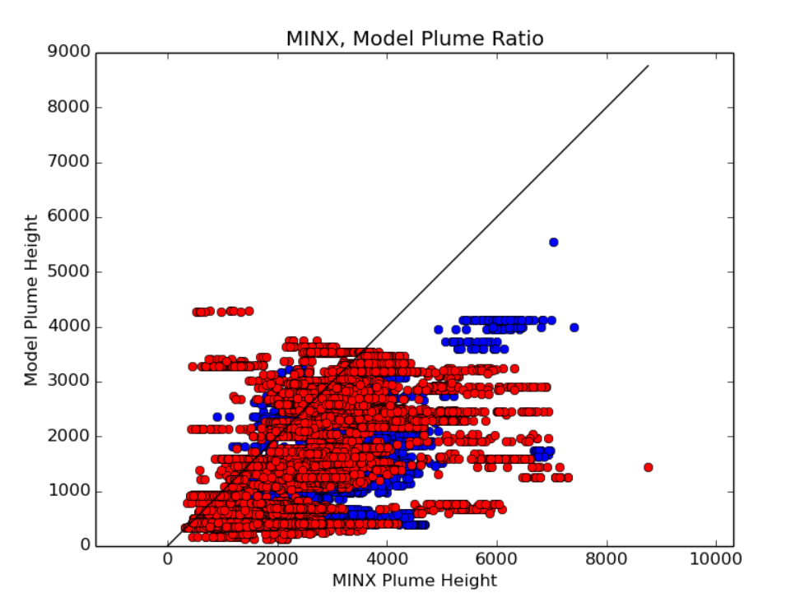
Results (Apr-Oct 2017, P98)
Notes:
Note on percentiles: Used 98 in this example. Can look at the 50th percentile results, not much difference in results (more cluttered in displays though, 2x more plumes), though cut out some other weird outliers.
When going to 99.9 percentile, cleans out a lot of potentially import trends. Otherwise, increasing percentile does not noticeably improve the overall result.
Stats definitions:
RMSD – Root Mean Square Deviation, sample standard deviation between predicted values and observed values. (how far is the model height from the MINX height)
Pearson Correlation Coefficient - measure of the linear correlation between two variables. (how predictable is the model value from the minx value)
R Squared (coefficient of determination) – measure of how much variance in the dependent variable is predicted by the independent variable (in this case, how well the regression line explains the scatter plot)
MAPE – shows accuracy of trend prediction (how good will our regression line be?)
MPE - average of percentage errors by which forecasts of a model differ from actual values of the quantity being forecast (how off are the model values?)

Slide 7
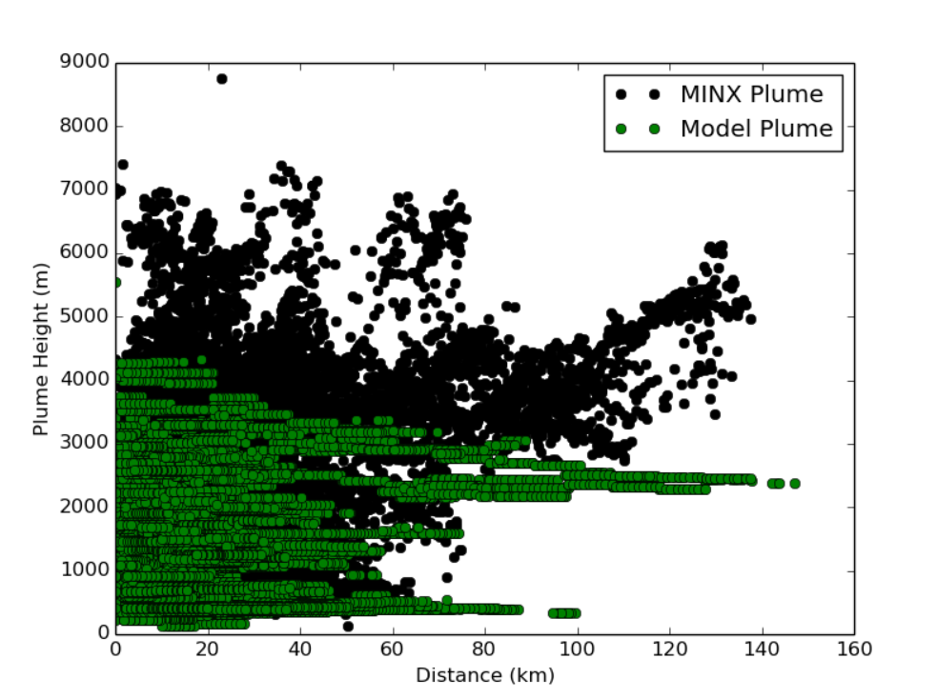
Plume Heights
Model by MINX plume height
Plume Height by Distance
Notes:
Note underestimation for the most part. Most variation in the model plume is near the origin of the plume

Slide 8
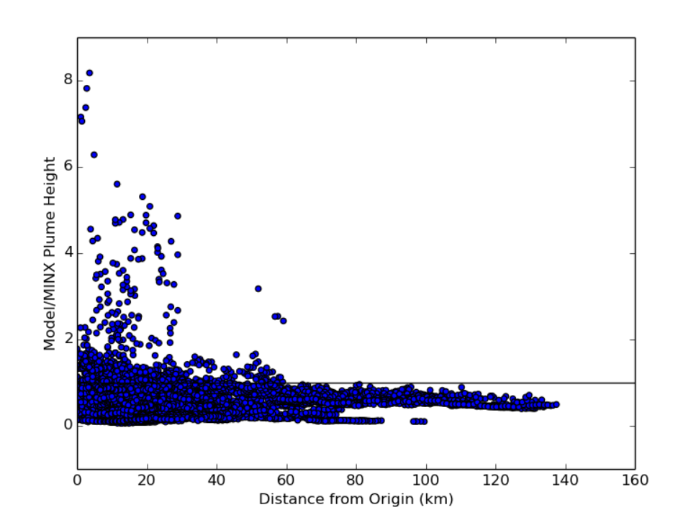
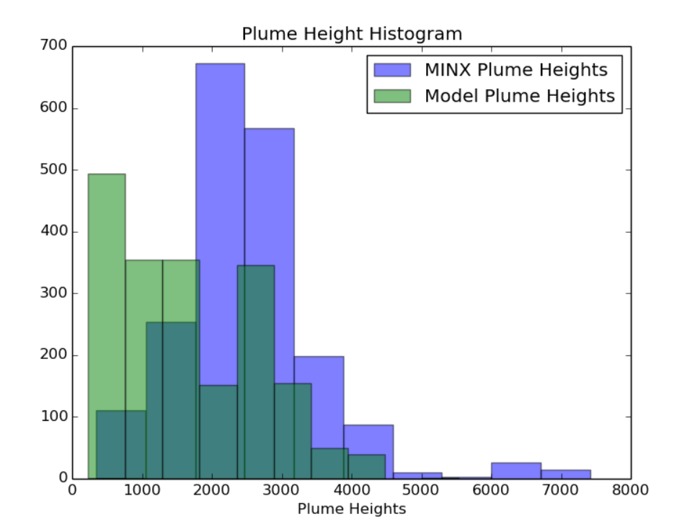
Plume Heights by Distance
Model/MINX Ratio
Plume Heights (0-10km)
Notes:
See majority is underestimation, but closer to the origin there is some overestimation by the model results.
Histogram displayed is only from 0-10km range. Note that we’re still seeing a general underestimation close to the origin of fire.
To see histogram for entire range: https://hpfx.science.gc.ca/~eld001/MINXResults/FW-GM_start00/plumeAnalysisApr_Oct/DistanceHist_thresh0_prct98.png

Slide 9
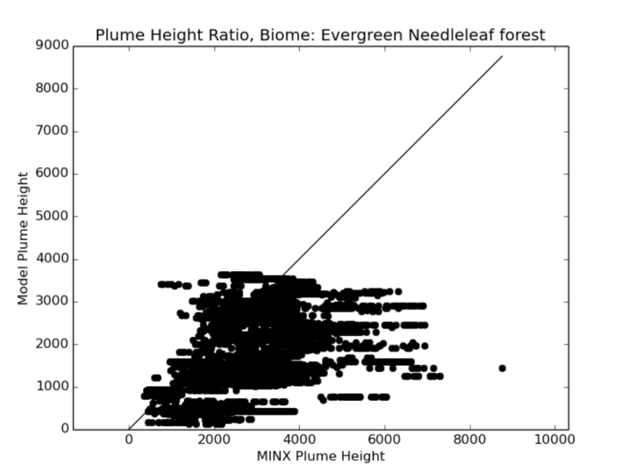
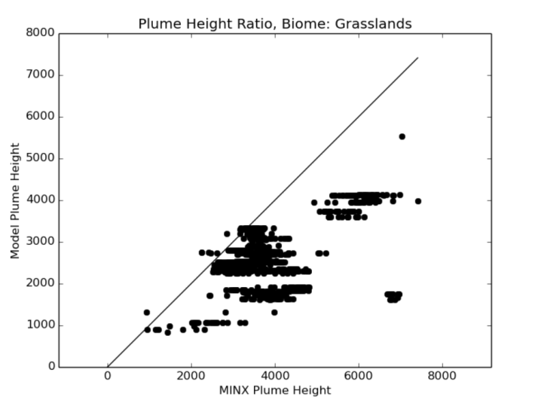
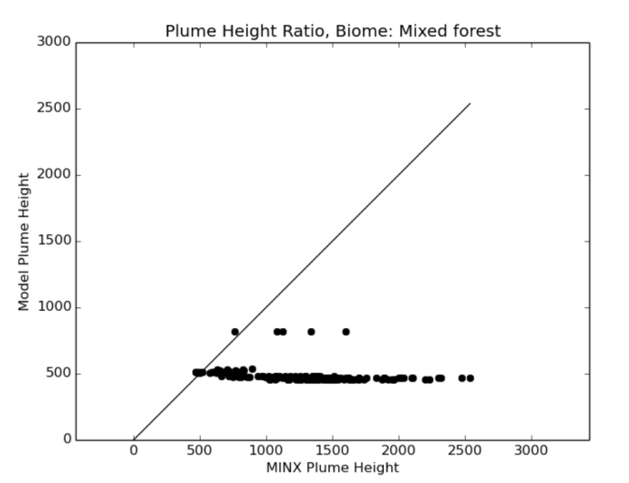
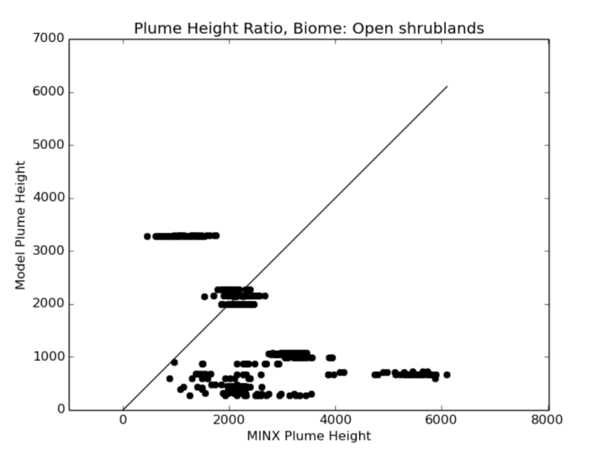
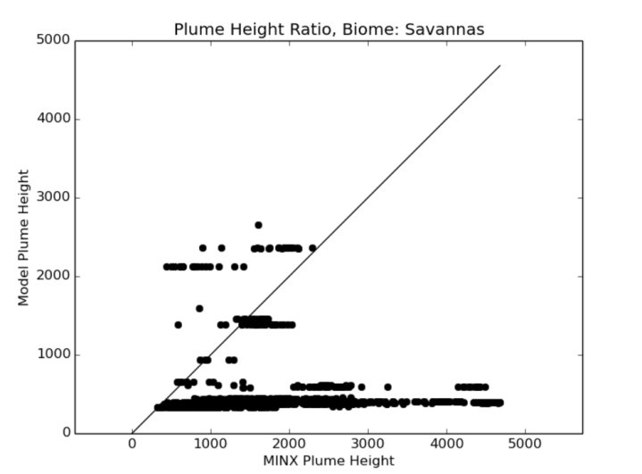
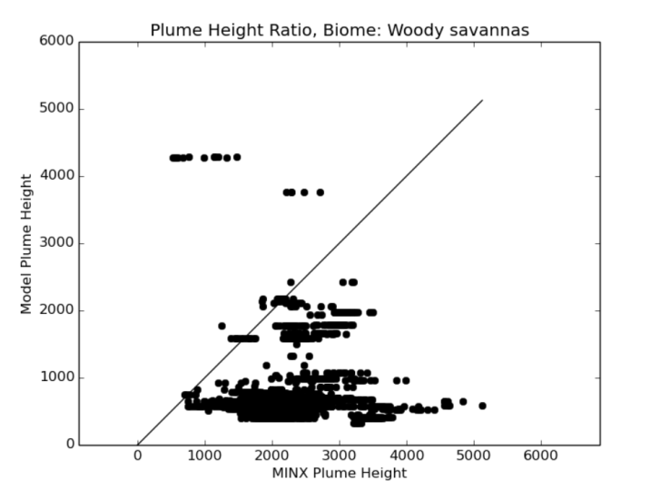
Breakdown by Biome
Notes:
Breakdown of all plume heights by biome.
Biome determination is by MINX (in the resulting raw plume data)
Note that most of them show underestimation. There are some overestimations in the evergreen needleleaf forest, open shrublands, savannas and woody savannas.
Currently, no good conclusions on this.

Slide 10
MINX Flaws
Using filtered height
User selection of red/blue band (affecting resolution)
Terrain offset (1 pixel = hundreds of meters)
Topography effects (depressions, valleys)
Thin aerosols
Fire Pixel masking, bowtie effect
Satellite pass time (10:30am)
Notes:
Filtered height: The height above sea level of the feature measured at this point corrected for wind and smoothed with a filter that considers only local variations
Red/Blue band: user can select which to digitize in. Usually use red unless can see terrain below.

Slide 11
Model Flaws
Using Nearest Neighbour
Low Resolution Grid
Other methods of determining plume height exist

Slide 12
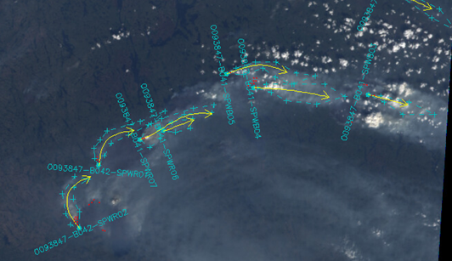
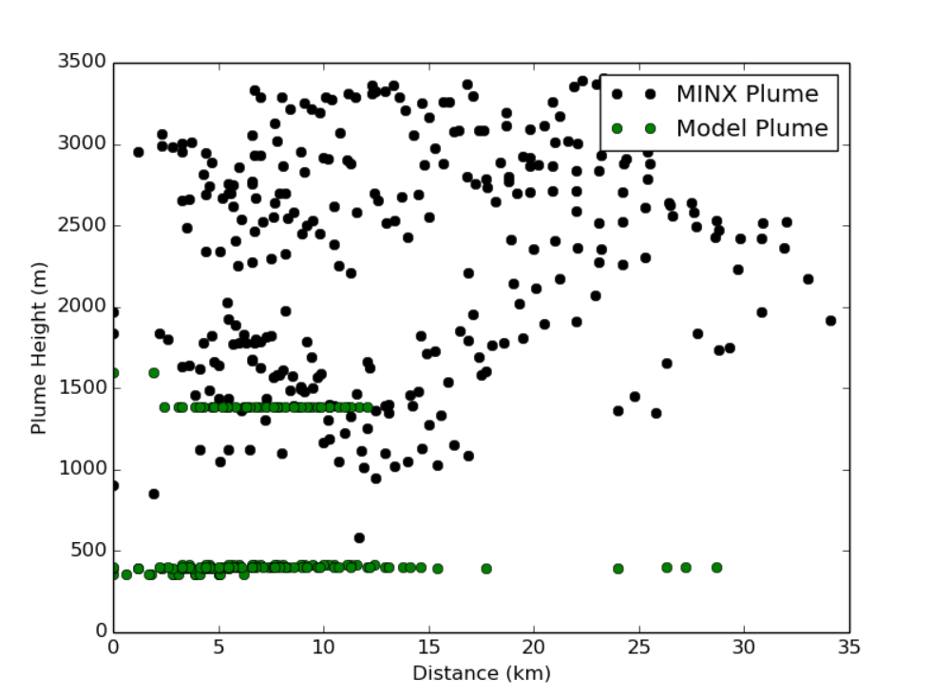
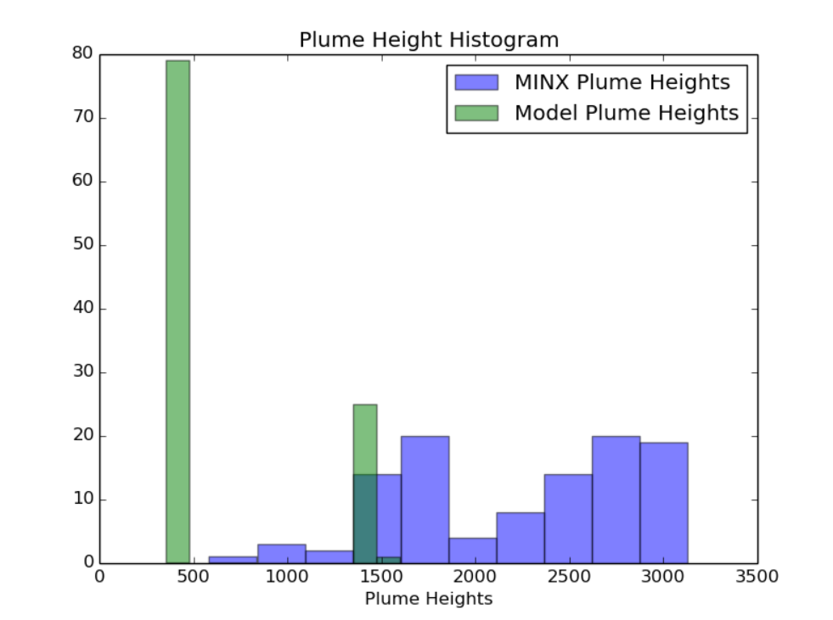
Case Study
Notes:
Less case study, more pointing out some issues with smaller plumes (the majority of plumes digitized)
Clear underestimation, misses details
https://hpfx.science.gc.ca/~eld001/MINXResults/FW-GM_start00/plumeAnalysisAug9CaseStudy/

Slide 13
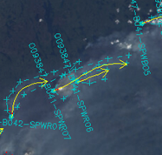
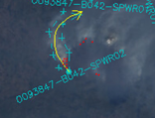
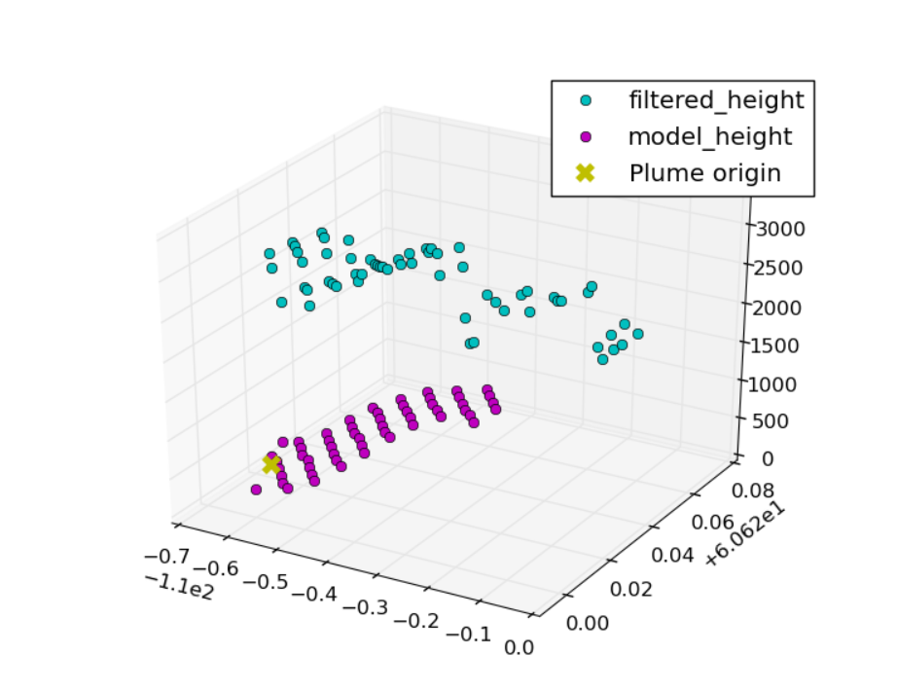
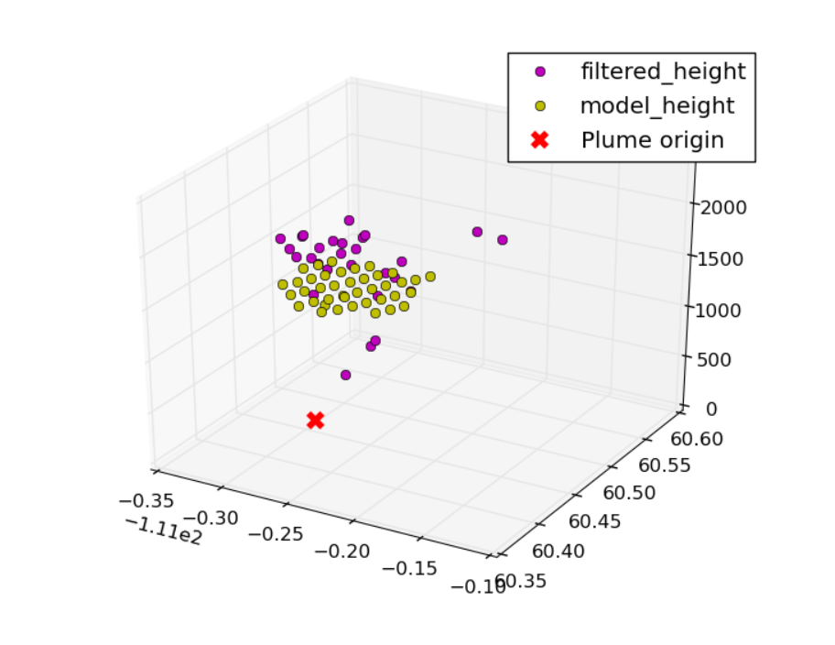
Case Study – 2 Plumes
O093847-B041-SPWR07
O093847-B042-SPWR02

Slide 14
In Progress/Future Goals
Different model (CFFEPS)
Comparison of CFFEPS to FireWork (monthly comparisons may also be useful)
Use different model plume height retrieval methods (10% of max PM2.5, CO levels, etc)
Incorporate CALIOP data to validate MINX results (really long-term goal)

Slide 15
Link to results
https://hpfx.science.gc.ca/~eld001/MINXResults/FW-GM_start00/

